Slide 1
Micro Credit Loan
Submitted by – Amruta Shah

Slide 2
Information
There are many poor families living in remote areas with not much sources of income, Since the communication via Telephone is important and how it affects a person’s life, this project provides their services to low income families and poor customers that can help them in the need of hour by providing Micro credit loan to telephone number.
This project can very useful for the poor customers and also for the people who needs balance in urgent. Since we all have already used the mobile financial services which was provided by Airtel, this can be very useful for the people

Slide 3
Problem Statement: -
A Microfinance Institution (MFI) is an organization that offers financial services to low income populations. MFS becomes very useful when targeting especially the unbanked poor families living in remote areas with not much sources of income. The Microfinance services (MFS) provided by MFI are Group Loans, Agricultural Loans, Individual Business Loans and so on.
Many microfinance institutions (MFI), experts and donors are supporting the idea of using mobile financial services (MFS) which they feel are more convenient and efficient, and cost saving, than the traditional high-touch model used since long for the purpose of delivering microfinance services. Though, the MFI industry is primarily focusing on low income families and are very useful in such areas, the implementation of MFS has been uneven with both significant challenges and successes.
Today, microfinance is widely accepted as a poverty-reduction tool, representing $70 billion in outstanding loans and a global outreach of 200 million clients.
We are working with one such client that is in Telecom Industry. They are a fixed wireless telecommunications network provider. They have launched various products and have developed its business and organization based on the budget operator model, offering better products at Lower Prices to all value conscious customers through a strategy of disruptive innovation that focuses on the subscriber.

Slide 4
Problem Statement: -
They understand the importance of communication and how it affects a person’s life, thus, focusing on providing their services and products to low income families and poor customers that can help them in the need of hour.
They are collaborating with an MFI to provide micro-credit on mobile balances to be paid back in 5 days. The Consumer is believed to be defaulter if he deviates from the path of paying back the loaned amount within the time duration of 5 days. For the loan amount of 5 (in Indonesian Rupiah), payback amount should be 6 (in Indonesian Rupiah), while, for the loan amount of 10 (in Indonesian Rupiah), the payback amount should be 12 (in Indonesian Rupiah).
The sample data is provided to us from our client database. It is hereby given to you for this exercise. In order to improve the selection of customers for the credit, the client wants some predictions that could help them in further investment and improvement in selection of customers.

Slide 5
Problem Statement: -
Build a model which can be used to predict in terms of a probability for each loan transaction, whether the customer will be paying back the loaned amount within 5 days of insurance of loan. In this case, Label ‘1’ indicates that the loan has been payed i.e. Non- defaulter, while, Label ‘0’ indicates that the loan has not been payed i.e. defaulter.

Slide 6
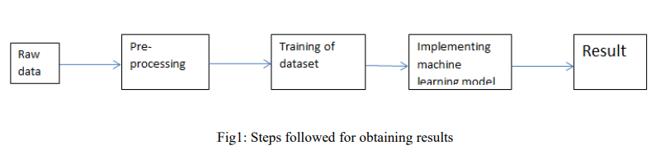
Methodology:-
The steps followed in this work, right from the dataset preparation to obtaining results are represented in Fig.

Slide 7
EDA (Exploratory Data Analysis):-
Import libraries: -
Import pandas as pd # for data manipulation
Import numpy as np # for mathematical calculations
Import seaborn as sns # for data visualization
Import matplotlib.pyplot as plt #for graphical analysis
%matplotlib inline
Import warnings # to ignore any warnings

Slide 8
Technical Requirements:
Mathematical Summary:
Dimensions of Dataset: There are 36 columns and 209593 rows in this dataset.
Null Values: There are no null values in this dataset.
Skewness: Skewness is present in almost every column Statistical. Summary: Standard deviation is very high in most of the columns.
Minimum negative values are present in the dataset.
There is lot of difference between mean and 50th percentile, which means data is skewed There is lot of difference between 75th percentile and max, which means there are outliers.
Data Sources: The sample data is provided to us from our client database. In order to improve the selection of customers for the credit, the client wants some predictions that could help them in further investment and improvement in selection of customers. In this Project, Label ‘1’ indicates that the loan has been paid within 5 days i.e. Non- defaulter, while, Label ‘0’ indicates that the loan has not been paid within 5 days i.e. defaulter.

Slide 9
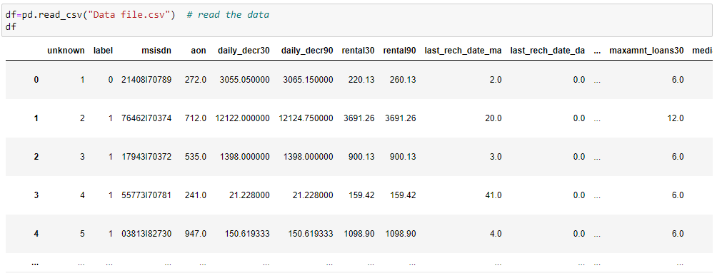
Load Dataset

Slide 10
Observations
Dimensions of Dataset: There are 36 columns and 209593 rows in this dataset.
Null Values: There are no null values in this dataset.
Skewness: Skewness is present in almost every column Statistical. Summary: Standard deviation is very high in most of the columns.
Minimum negative values are present in the dataset.
There is lot of difference between mean and 50th percentile, which means data is skewed There is lot of difference between 75th percentile and max, which means there are outliers.

Slide 11
Data Visualization
We now have a basic idea about the data. We need to extend that with some visualizations. We are going to look at three types of plots:
Univariate plots to better understand each variable.
Bivariate plots to find relationship between two variables,
Multivariate plots to better understand the relationships between variables.

Slide 12
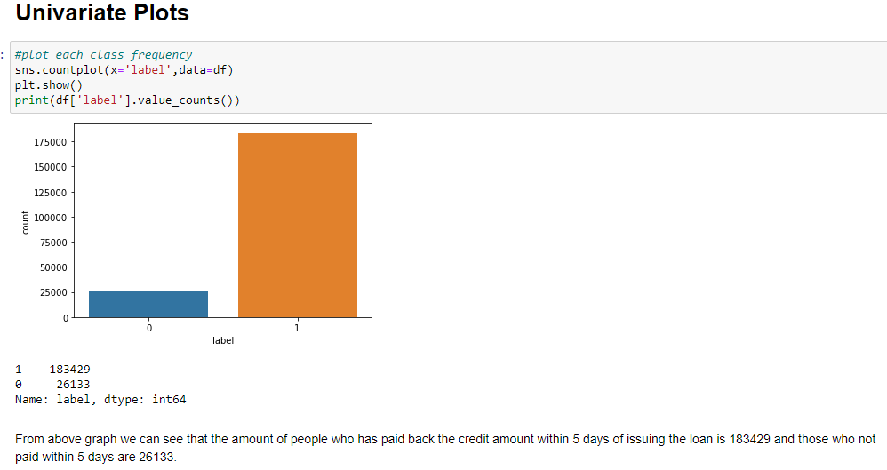
Univariate Plots:-

Slide 13
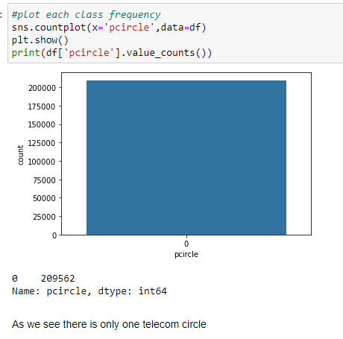

Slide 14
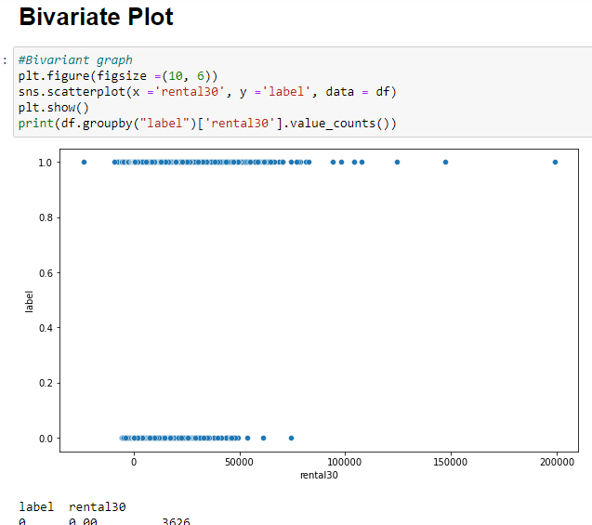
Bivariate Plot

Slide 15
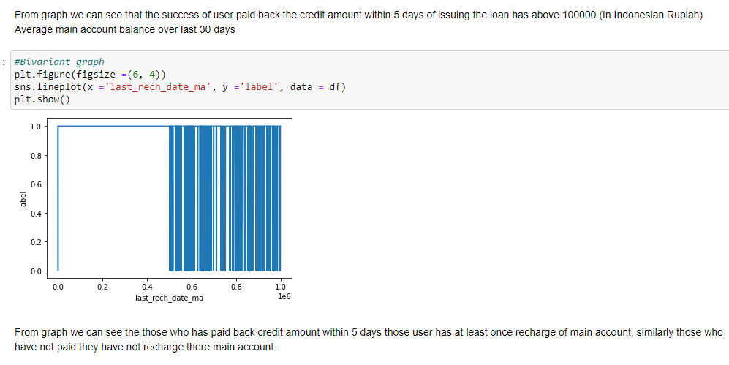

Slide 16
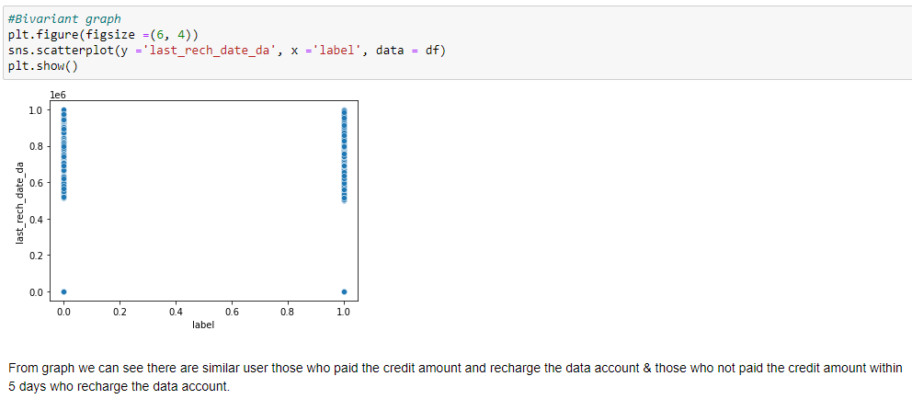

Slide 17
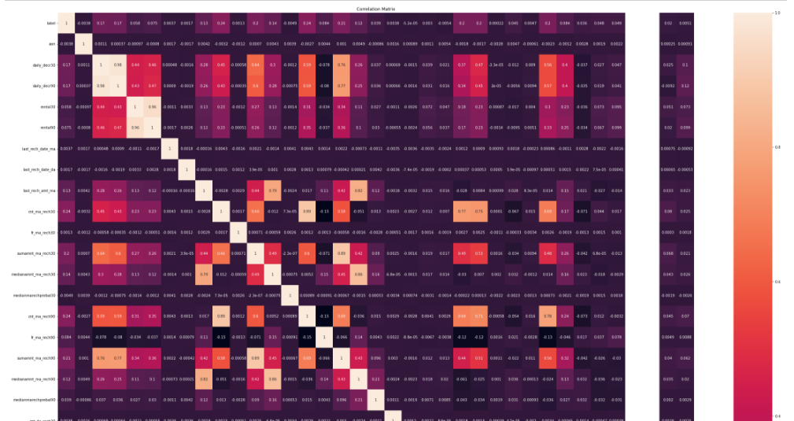
Multivariate Plot

Slide 18
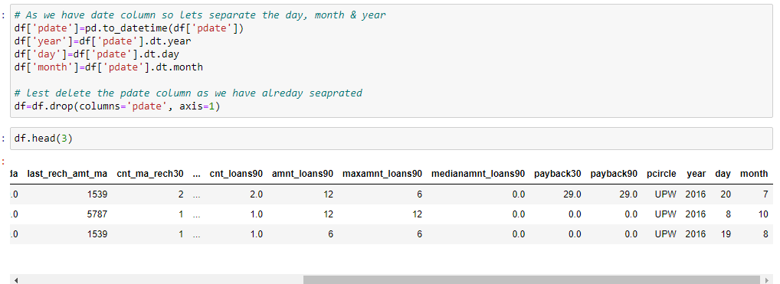
Data Pre-processing:-
First of all I have dropped irrelevant columns 'unknown','msisdn'.
Then check for the duplicates some duplicates are found which is delated. After dropping the duplicated the shape of dataset is (rows=209562, columns=35).
Moving further as we have date columns so I have separated them into year, day & month basis as shown below.

Slide 19
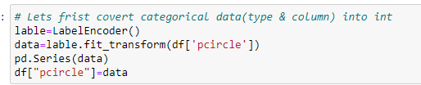
Data Pre-processing:-
As our dataset has objective type data”pcircle” so covert them into int by using Encoding method as shown.
Columns dropped based on Correlation:
Removed these 14 columns which are correlation less than 0.01 with the target variable.
['month','cnt_loans90','cnt_da_rech30','last_rech_date_ma','cnt_da_rech90','last_rech_date_da','fr_ma_rech30','maxamnt_loans30','fr_da_rech30','aon','medianmarechprebal30','fr_da_rech90','pcircle','year']

Slide 20
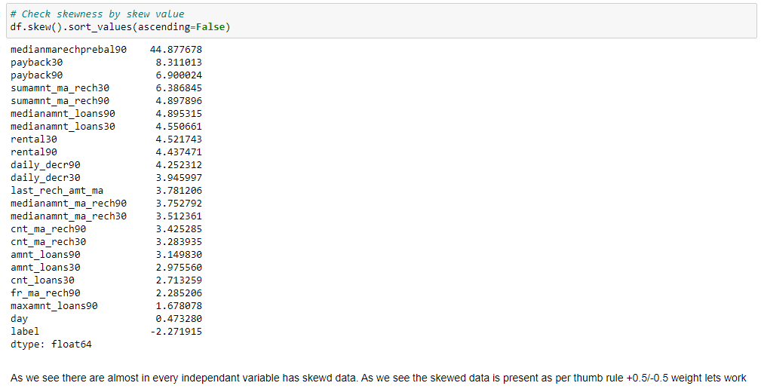
Check Skewness

Slide 21
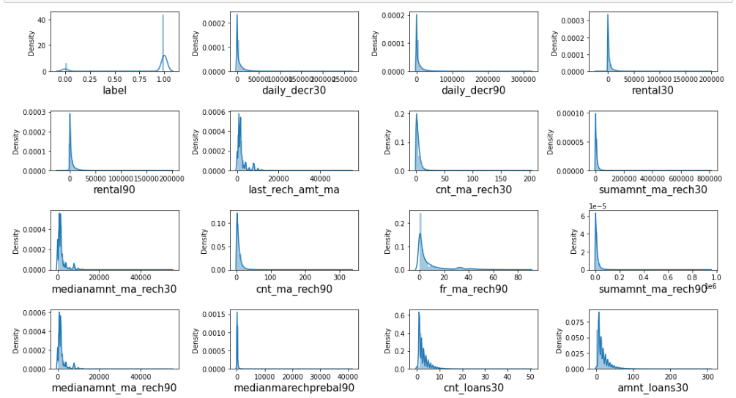
Distribution plot for skewness

Slide 22

Power Transformation to remove skewness

Slide 23
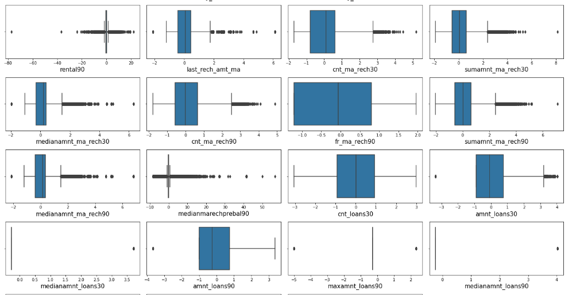
Distribution to see outliers

Slide 24
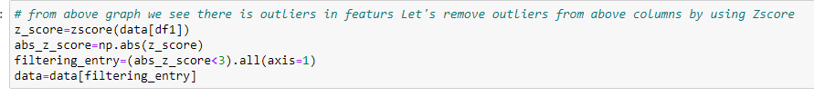
ZScore to remove outliers

Slide 25
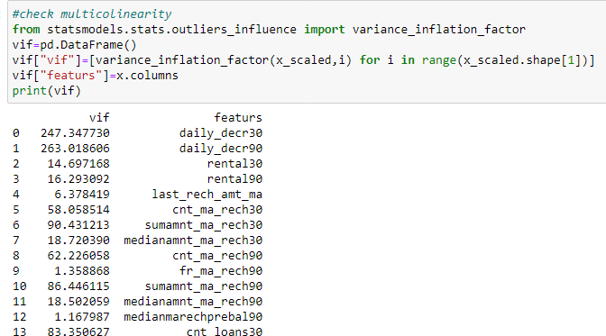
Multicollinearity by VIF

Slide 26
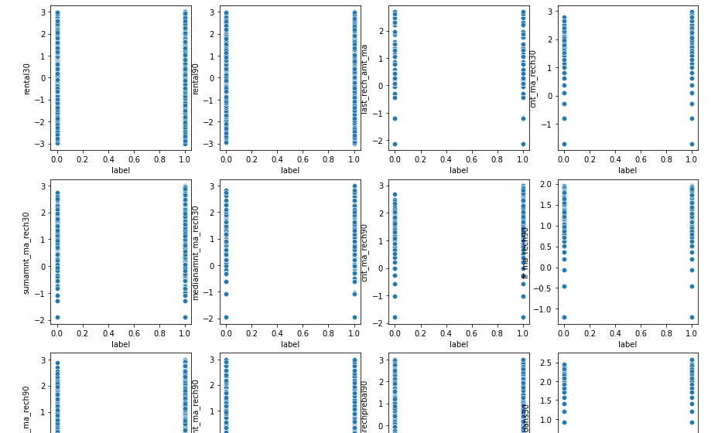
Data Inputs- Logic- Output Relationships

Slide 27
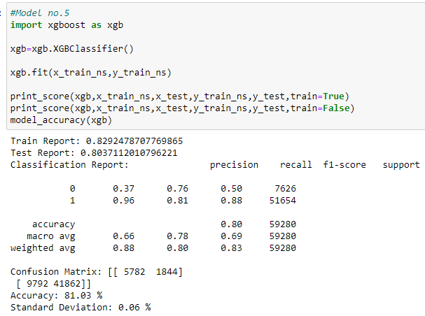
Build the models & select best one

Slide 28
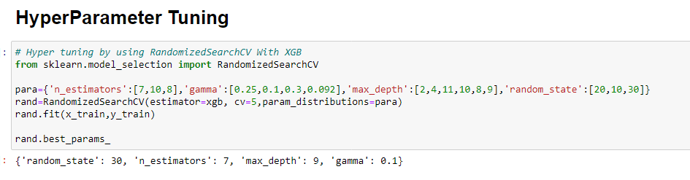
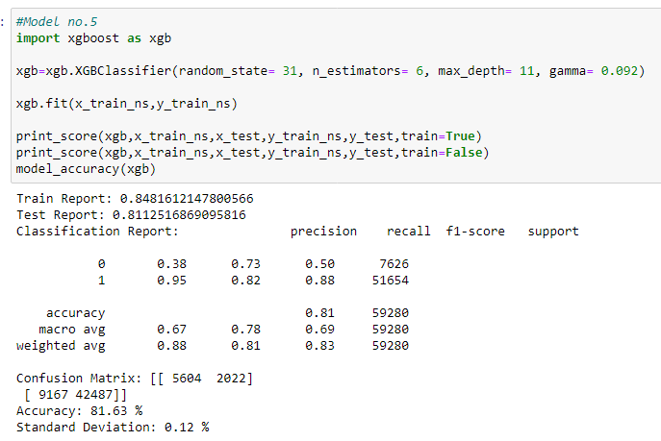

Slide 29
In this project we build the regression model that can predict car price of used car. The challenge behind predicting models is EDA & feature selection. We have gone through how to implement the entire machine learning pipeline, and we have an intuitive understanding of machine learning algorithms. The larger the dataset gets, the more complex each of the mentioned steps gets. Therefore, using this as a base will help while you build your knowledge of machine learning pipelines. This Paper has presented a supervised housing sales price learning model which used machine learning algorithms to predict the price. We used different machine learning algorithm to check the accuracy of price prediction.
Conclusion and Future Scope: -

